Slide 1
Introduction To Automation Testing
- G Sunil Kumar

Slide 2
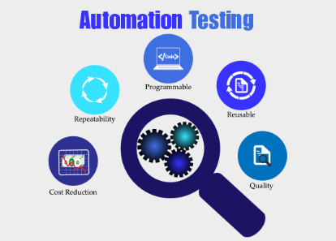
TABLE OF CONTENTS
What is Automation Testing?
Why Automated Testing?
Which Test Cases to Automate?
Automated Testing Process
Test tool selection
Define the scope of Automation
Planning, Design, and Development
Test Execution
Framework for Automation
Automation Tool Best Practices
Benefits of Automation Testing
Different types of software testing that can be automated
How to Choose an Automation Tool?
Automation Testing Tools

Slide 3
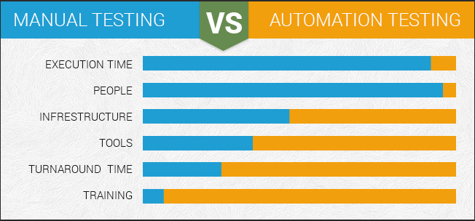
What is Automation Testing?
Manual Testing is performed by a human sitting in front of a computer carefully executing the test steps.
Automation Testing means using an automation tool to execute your test case suite.
The automation software can also enter test data into the System Under Test, compare expected and actual results and generate detailed test reports. Test Automation demands considerable investments of money and resources.
Successive development cycles will require execution of same test suite repeatedly. Using a test automation tool, it's possible to record this test suite and re-play it as required. Once the test suite is automated, no human intervention is required. This improved ROI of Test Automation. The goal of Automation is to reduce
the number of test cases to be run
manually and not to eliminate
Manual Testing altogether.

Slide 4
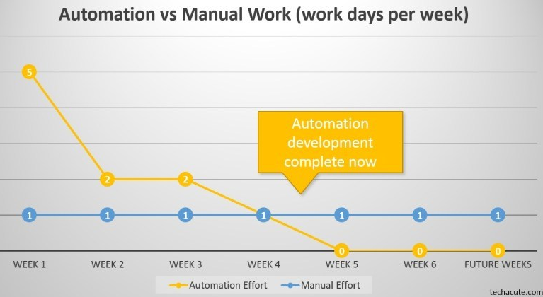
Why Automated Testing?
Automated software testing is important due to the following reasons:
Manual Testing of all workflows, all fields, all negative scenarios is time and money consuming
It is difficult to test for multilingual sites manually
Automation does not require Human intervention. You can run automated test unattended (overnight)
Automation increases the speed of
test execution
6. Automation helps increase Test
Coverage
Manual Testing can become boring
and hence error-prone.

Slide 5
Which Test Cases to Automate?
Test cases to be automated can be selected using the following criterion to increase the automation ROI
High Risk - Business Critical test cases
Test cases that are repeatedly executed
Test Cases that are very tedious or difficult to perform manually
Test Cases which are time-consuming
The following category of test cases are not suitable for automation:
Test Cases that are newly designed and not executed manually at least once
Test Cases for which the requirements are frequently changing
Test cases which are executed on an ad-hoc basis.

Slide 6
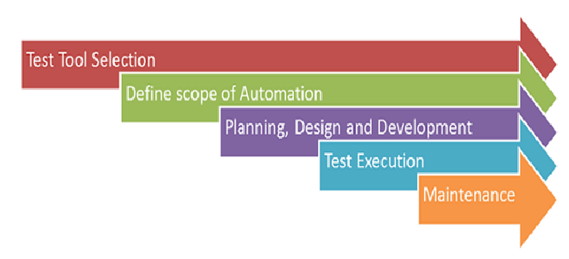
Automated Testing Process

Slide 7
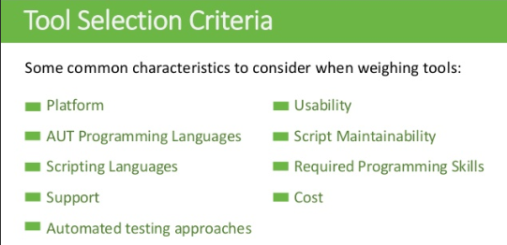
Automation Test tool selection
Test Tool selection largely depends on the technology the Application Under Test is built on. For instance, QTP does not support Informatica. So QTP cannot be used for testing Informatica applications. It's a good idea to conduct a Proof of Concept of Tool on AUT.

Slide 8
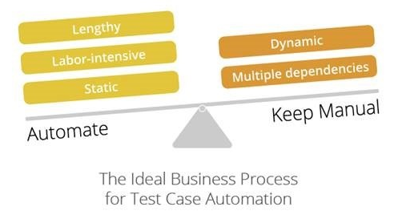
Define the scope of Automation
The scope of automation is the area of your Application Under Test which will be automated. Following points help determine scope:
The features that are important for the business
Scenarios which have a large amount of data
Common functionalities across applications
Technical feasibility
The extent to which business components
are reused
The complexity of test cases
Ability to use the same test cases for
cross-browser testing

Slide 9
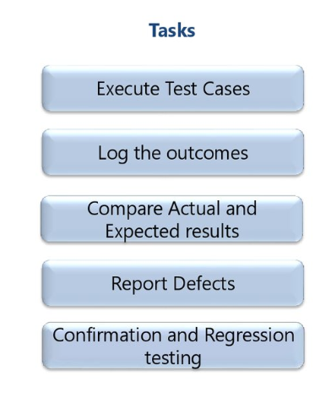
Test Execution
Automation Scripts are executed during this phase.
The scripts need input test data before there are set to run.
Once executed they provide detailed test reports.
Execution can be performed using the
automation tool directly
or through the Test Management tool which
will invoke the automation tool.
Example: Quality center is the Test
Management tool which in turn it will invoke
QTP for execution of automation scripts.
Scripts can be executed in a single machine
or a group of machines.
5. The execution can be done during the night,
to save time.

Slide 10
Maintenance
As new functionalities are added to the System Under Test with successive cycles, Automation Scripts need to be added, reviewed and maintained for each release cycle. Maintenance becomes necessary to improve the effectiveness of Automation Scripts.

Slide 11
Framework for Automation
A framework is set of automation guidelines which help in
Maintaining consistency of Testing
Improves test structuring
Minimum usage of code
Less Maintenance of code
Improve re-usability
Non Technical testers can be involved in code
The training period of using the tool can be reduced
Involves Data wherever appropriate

Slide 12
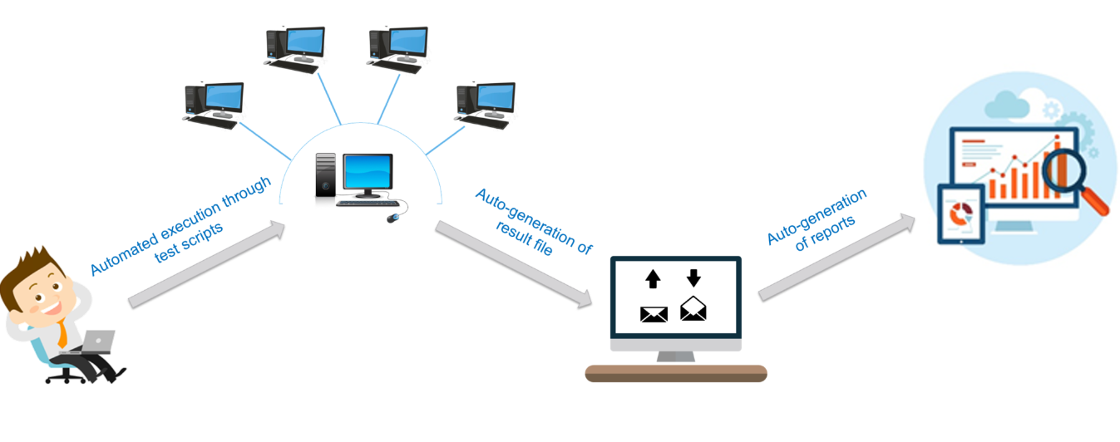
Types of Automation Framework
Data Driven Automation Framework
Keyword Driven Automation Framework
Modular Automation Framework
Hybrid Automation Framework
Behavioral Driven Development Framework

Slide 13
Automation Tool Best Practices
To get maximum ROI of automation, observe the following
The scope of Automation needs to be determined in detail before the start of the project. This sets expectations from Automation right.
Select the right automation tool: A tool must not be selected based on its popularity, but it's fit to the automation requirements.
Choose an appropriate framework
Scripting Standards- Standards have to be followed while writing the scripts for Automation. Some of them are-
Create uniform scripts, comments, and indentation of the code

Slide 14
Automation Tool Best Practices – Contd..
Adequate Exception handling - How error is handled on system failure or unexpected behavior of the application.
User-defined messages should be coded or standardized for Error Logging for testers to understand.
Measure metrics- Success of automation cannot be determined by comparing the manual effort with the automation effort but by also capturing the following metrics.
Percent of defects found
The time required for automation testing for each and every release cycle
Minimal Time is taken for release
Customer Satisfaction Index
Productivity improvement
The above guidelines if observed can greatly help in making your automation successful.

Slide 15
Benefits of Automation Testing
Following are benefits of automated testing:
70% faster than the manual testing
Wider test coverage of application features
Reliable in results
Ensure Consistency
Saves Time and Cost
Improves accuracy
Human Intervention is not required while execution
Increases Efficiency
Better speed in executing tests
Re-usable test scripts
Test Frequently and thoroughly
More cycle of execution can be achieved through automation
Early time to market

Slide 16
Types of testing that can be automated
Smoke Testing
Unit Testing
Integration Testing
Functional Testing
Keyword Testing
Regression Testing
Data Driven Testing
Black Box Testing

Slide 17
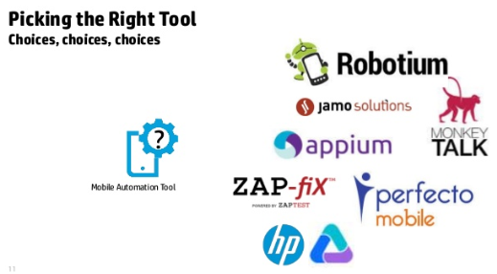
How to Choose an Automation Tool?
Selecting the right tool can be a tricky task. Following criterion will help you select the best tool for your requirement-
Environment Support
Ease of use
Testing of Database
Object identification
Image Testing
Error Recovery Testing

Slide 18
How to Choose an Automation Tool? – Contd..
Object Mapping
Scripting Language Used
10. Support for various types of test - including functional, test management, mobile, etc...
11. Support for multiple testing frameworks
Easy to debug the automation software scripts
Ability to recognize objects in any environment
14. Extensive test reports and results
15. Minimize training cost of selected tools
16. Tool selection is one of biggest challenges to be tackled before going for automation.
First, Identify the requirements, explore various tools and its capabilities,
set the expectation from the tool and go for a Proof Of Concept.

Slide 19
Automation Testing Tools
There are tons of Functional and Regression Testing Tools available in the market.
Here are 5 best tools certified by our experts
Ranorex Studio
Ranorex Studio is an all-in-one tool for automating functional UI tests, regression tests, data-driven tests
and much more. Ranorex Studio includes an easy to use click-and-go interface to automate tests for
web, desktop, and mobile applications.
Features:
Functional UI and end-to-end testing on desktop, web, and mobile
Cross-browser testing
SAP, ERP, Delphi and legacy applications.
iOS and Android
Run tests locally or remotely, in parallel or distribute on a Selenium Grid
Robust reporting
mabl
mabl delivers scriptless end-to-end test automation, integrated with your delivery pipeline,
so you can focus on improving your app.
Features:
Proprietary machine learning models automatically identify and surface application issues
Tests are automatically repaired when UI changes
Automated regression insights on every build

Slide 20
Automation Testing Tools – Contd ..
Testim
Testim uses artificial intelligence to speed-up the authoring, execution, and maintenance of automated tests. It uses dynamic locators that learn with every execution and adapts to code changes, minimizing maintenance time spent fixing flaky tests. The outcome is self-healing tests with results you can trust.
root cause analysis
cross browser testing
visual validations
integrate with your CI/CD; JIRA, Slack, Git, Trello
your choice of GUI + JS based custom code
Selenium
It is a software testing tool used for Regression Testing. It is an open source testing tool that provides playback and recording facility for Regression Testing. The Selenium IDE only supports Mozilla Firefox web browser.
It provides the provision to export recorded script in other languages like Java, Ruby, RSpec, Python, C#, etc
It can be used with frameworks like JUnit and TestNG
It can execute multiple tests at a time

Slide 21
Automation Testing Tools – Contd ..
Autocomplete for Selenium commands that are common
Walkthrough tests
Identifies the element using id, name, X-path, etc.
Store tests as Ruby Script, HTML, and any other format
It provides an option to assert the title for every page
It supports selenium user-extensions.js file
It allows to insert comments in the middle of the script for better understanding and debugging

Slide 22
Automation Testing Tools – Contd ..
QTP (MicroFocus UFT)
QTP is widely used for functional and regression testing, it addresses every major software application and environment. To simplify test creation and maintenance, it uses the concept of keyword driven testing. It allows the tester to build test cases directly from the application.
It is easier to use for a non-technical person to adapt to and create working test cases
It fix defects faster by thoroughly documenting and replicating defects for developer
Collapse test creation and test documentation at a single site
Parameterization is easy than WinRunner
QTP supports .NET development environment
It has better object identification mechanism
It can enhance existing QTP scripts without "Application Under Test" is available, by using the active screen

Slide 23
Automation Testing Tools – Contd ..
Rational Functional Tester
It is an Object-Oriented automated Functional Testing tool that is capable of performing automated functional, regression, data-driven testing and GUI testing. The main features of this tool are
It supports a wide range of protocols and applications like Java, HTML, NET, Windows, SAP, Visual Basic, etc.
It can record and replay the actions on demand
It integrates well with source control management tools such as Rational Clear Case and Rational Team Concert integration
It allows developers to create keyword associated script so that it can be re-used
Eclipse Java Developer Toolkit editor facilitates the team to code test scripts in Java with Eclipse
It supports custom controls through proxy SDK (Java/.Net)
It supports version control to enable parallel development of test scripts and concurrent usage by geographically distributed team

Slide 24
Automation Testing Tools – Contd ..
WATIR
It is an open source testing software for regression testing. It enables you to write tests that are easy to read and maintain. Watir supports only internet explorer on windows while Watir webdriver supports Chrome, Firefox, IE, Opera, etc.
It supports multiple browsers on different platforms
Rather than using proprietary vendor script, it uses a fully-featured modern scripting language Ruby
It supports your web app regardless of what it is developed in
SilkTest
Silk Test is designed for doing functional and regression testing. For e-business application, silk test is the leading functional testing product. It is a product of Segue Software takeover by Borland in 2006. It is an object-oriented language just like C++. It uses the concept of an object, classes, and inheritance. Its main feature includes
It consists of all the source script files
It converts the script commands into GUI commands. On the same machine, commands can be run on a remote or host machine
To identify the movement of the mouse along with keystrokes, Silktest can be executed. It can avail both playback and record method or descriptive programming methods to get the dialogs
It identifies all controls and windows of the application under test as objects and determines all of the attributes and properties of each window
Download SilkTest

Slide 25
Conclusion
  The right selection of automation tool, testing process, and team, are important players for automation to be successful.
  Manual and automation methods go hand-in-hand for successful testing.
REFERENCES
  Automation Testing fundamentals - https://www.guru99.com/automation-testing.html
  Automated Software Testing - https://www.tutorialspoint.com/software_testing_dictionary/automated_software_testing

Slide 26
THANK YOU

Slide 27


